Slide 1
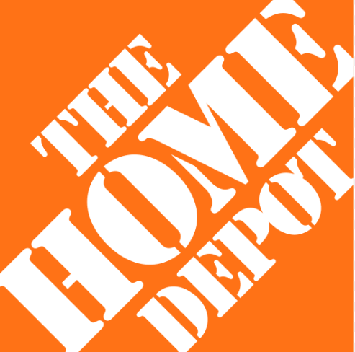

Why this review matters
01
Online drives in-store
eCommerce
Over 60–70% of Weiser revenue closes in-store, but the online Product Page is where the decision is made. The PIP is the most critical real estate in the purchase funnel.
Performance
Review – Case Study
02
Conversion is below potential
Weiser × Home Depot Canada
High-traffic SKUs — some attracting over 115,000 annual visits — are converting at under 0.65%. Content gaps are measurably costing revenue.
Presented by: Yash Doshi | 2026
Weiser — #1 door hardware brand on HomeDepot.ca
03
Ratings signal trust gaps
166 SKUs · vs Schlage 144 · Defiant 69 · Yale 26
Several SKUs sit below 2.5 stars. Lower ratings directly correlate with weaker conversion and blended revenue per visit across the portfolio.
Lifetime Warranty · SmartKey Technology · Canadian Weather Tested
| Welcome Home (Cat 1) | Elements (Cat 2) | Collections + Smart Locks (Cat 3) |

Slide 2
Performance Overview — Where are we today?
Online sales TY vs LY | Revenue = Orders × AOV | Blended RPV = (Online + Attributed In-Store Revenue) ÷ Product Visits
Total online sales TY
Total orders TY
Avg conversion rate
Avg blended rev/visit
$5.46M
15,994
0.85%
$9.34
▲ 10.3% vs LY
▲ 3.4% vs LY
▲ from $8.79 LY
SKU | Line | Sales TY | Growth | Conv | Blended RPV
SKU 12 | Collections | $724,774 | +24.7% | 0.83% | $19.41
SKU 16 | Collections | $612,579 | +8.1% | 0.74% | $15.74
SKU 6 | Welcome Home | $454,616 | +7.0% | 1.09% | $16.43
SKU 20 | Collections | $389,975 | +6.1% | 0.99% | $24.39
SKU 7 | Welcome Home | $380,452 | +6.6% | 0.92% | $13.00
"Revenue is concentrated across a few key SKUs — but performance varies sharply in conversion and monetization efficiency."
KEY MESSAGE
Weiser × Home Depot Canada | Yash Doshi | 2026

Slide 3
Funnel Analysis — Where are we losing customers?
SKUs sorted by online visits TY — bars show traffic volume, line shows conversion efficiency
Chart 1: Online Visits TY
Chart 2: Conversion Rate TY (%)
SKU | Visits | Orders | Conv % | Diagnosis
SKU 15 | 117,298 | 713 | 0.61% | High traffic, low conv
SKU 16 | 118,087 | 871 | 0.74% | High traffic, mid conv
SKU 17 | 114,611 | 728 | 0.64% | High traffic, low conv
SKU 6 | 91,026 | 993 | 1.09% | Balanced winner
SKU 20 | 76,697 | 758 | 0.99% | Balanced winner
KEY MESSAGE:"SKU 15 and SKU 17 together attract 230K+ visits/year yet convert below 0.65%. That is a digital shelf problem, not a demand problem. Visits × Conversion Rate = Orders. Fixing conversion on these two SKUs to portfolio average (0.85%) would generate ~500 incremental orders per SKU annually"
TOTAL VISITS: Over 1.97 million product visits across the Weiser portfolio annually — every 0.1% conversion gain = ~2,000 incremental orders
Note: Top 5 SKUs shown
Weiser × Home Depot Canada | Yash Doshi | 2026

Slide 4
Monetization — Are we making money efficiently per visit?
Blended revenue per visit TY vs LY · Store dependency ratio · AOV online vs in-store comparison
Blended Revenue per Visit — TY vs LY
Store Dependency Ratio (%)
AOV Online vs Store — sorted by online premium
SKU | Online | Store | Premium
SKU 12 | $899.94 | $765.67 | +$134.27
SKU 16 | $704.14 | $627.00 | +$77.14
SKU 5 | $545.15 | $496.50 | +$48.65
SKU 2 | $395.88 | $354.00 | +$41.88
SKU 7 | $458.32 | $419.00 | +$39.32
SKU 1 | $312.64 | $274.00 | +$38.64
SKU 6 | $455.13 | $417.33 | +$37.80
SKU 20 | $507.86 | $475.00 | +$32.86
SKU 18 | $496.19 | $475.00 | +$21.19
>$100
$50–100
< $50 premium
Online buyers spend more per order — SKU 12 online AOV is $134 higher than in-store. Better PIPs attract more decided, higher-value customers.
KEY MESSAGE: "SKU 20 generates $24.39 blended RPV — nearly 10× more than SKU 10.
High AOV alone does not guarantee visit efficiency: SKU 12 leads on AOV but SKU 20 leads on RPV."
Weiser × Home Depot Canada | Yash Doshi | 2026

Slide 5
Customer Signal — What's driving the gap?
SKU Ratings — Trust Tiers
| Monthly avg product rating vs avg conversion rate | SKU-level trust tier analysis |
Monthly Avg Rating
SKU | Avg Rating | Conv TY | Signal
SKU 12 | 4.47 ★★★★ | 0.83% | Strong trust
SKU 17 | 4.39 ★★★★ | 0.64% | High rating, low conv
SKU 18 | 4.38 ★★★★ | 0.78% | Strong trust
SKU 14 | 4.37 ★★★★ | 0.80% | Strong trust
SKU 9 | 2.37 ★★ | 0.82% | Trust risk
SKU 10 | 2.38 ★★ | 0.77% | Trust risk
SKU 11 | 2.05 ★★ | 0.91% | Trust risk
Monthly Avg Conversion Rate
KEY MESSAGE: November (rating 3.75) and December (conv 1.67%) show the strongest paired performance — trust and timing are compounding. SKU 11 at 2.05 stars is the single largest trust liability in the portfolio."
Weiser × Home Depot Canada | Yash Doshi | 2026

Slide 6
YoY Growth Decomposition — Why did growth happen?
Sales growth vs Visits growth vs Orders growth · Top 10 movers · Traffic-led vs conversion-led growth
SKU 9 — Sales +26.2%
Sales surged 26.2% despite visits falling 0.9% — growth was entirely conversion-led. Investigate what changed (price, content, reviews).
SKU 12 — Sales +24.7%
Strong growth driven by AOV increase ($900 AOV). Orders declined 1.1% — AOV is the engine here, not volume.
SKU 13 — Orders +18.1%
Orders grew 18.1% but visits fell 0.7% — a clear conversion efficiency improvement. Best practice to scale.
KEY MESSAGE : "Revenue = Orders × AOV. Sales +10.3%, Orders +3.4% — the 6.9-point delta is Avg Order Value expansion, not volume growth. AOV gains are fragile; sustainable growth requires converting more of the 1.97M visits we already have.”
Weiser × Home Depot Canada | Yash Doshi | 2026

Slide 7
01
Conversion gap — digital shelf priority
High-traffic SKUs (SKU 15 at 117K visits, SKU 17 at 114K) are converting at under 0.65% — the lowest in the portfolio. This is a content and trust gap, not a demand problem. Closing even half the gap to portfolio average (0.85%) would generate ~2,200 incremental orders annually.
Key
Insights
02
Monetization inefficiency — Blended Revenue Per Visit spread
Blended revenue per visit ranges from $2.51 (SKU 10) to $24.39 (SKU 20) — nearly a 10× gap. SKUs with the highest store dependency (69%+) indicate customers discover online but purchase in-store, making PIP quality the primary sales lever across channels.
Analysis Summary
Weiser × Home Depot Canada
| Yash Doshi | 2026 |
03
Trust signals — ratings drive conversion
SKU 11, 10, and 9 carry average ratings below 2.5 stars and rank among the weakest converters and monetizers. November (3.75 avg rating) shows the strongest blended performance. Improving trust signals on low-rated SKUs is the highest-leverage content action available.
Data Note: Dataset contains fictional data created for this exercise. Not based on actual Home Depot performance.
Root cause: the digital shelf — the PIP — is not converting traffic it already has. The next slides show what those pages look like and what we do about it."

Slide 8
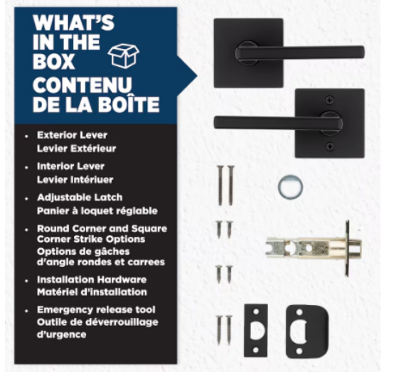
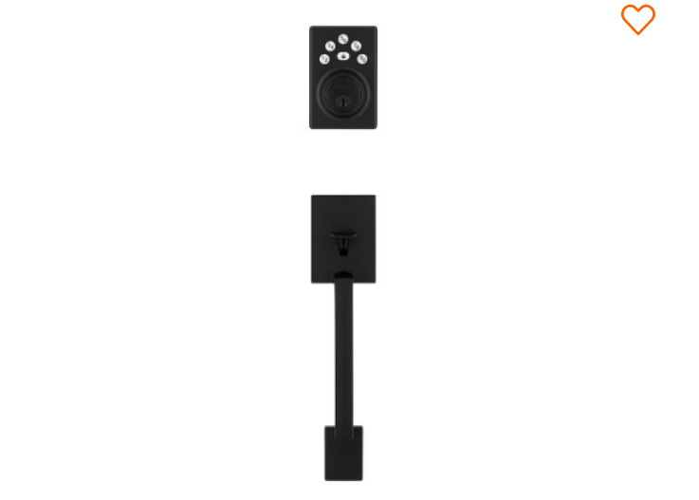
Digital Shelf Audit — The PIP Problem
Live analysis of 4 Weiser product pages on HomeDepot.ca · Issues annotated below
homedepot.ca › … › Branton x Daylon x Elements Electronic Deadbolt
homedepot.ca › … › Halifax Matte Black Hall/Closet Passage Interior Door Handle
⚠ Title: 3 product names combined — confusing
Weiser Branton x Daylon x Elements
Electronic Deadbolt Matte Black…
Weiser Halifax Matte Black
Hall/Closet Passage Interior Door Handle
★★★☆☆ 44 reviews
★★★★☆ 501 reviews
CAD $189.00
CAD $32.98
OVERVIEW: The Branton & Daylon Safe Lock handles by Weiser were designed with one thought in mind, providing you with quality, dependability, and security. The perfect starter home package…
OVERVIEW : Elements by Weiser was designed with one thought in mind, providing you with quality, dependability, and security. A favoured mix of styles and finishes ensure that you provide the look…
🔴 CRITICAL: "Connectivity: Not Connected" on an electronic keypad lock — incorrect spec misleads buyers
⚠ Only 1 product image — no in-context shot
⚠ "Passage" undefined for non-expert buyers — causes confusion
⚠ Only 1 product image — no lifestyle, no install
🔴 38 unanswered Q&As = 38 lost conversions. Each question = missing PIP content.
⚠ Description is feature-led, not benefit-led — no "why buy this" story
SPECIFICATIONS : Material: Zinc | Commercial/Residential: Residential | Handle Shape: Round | Rosette Shape: Round
SPECIFICATIONS
Connectivity: Not Connected | Smart Technology: No | Voice Assistant: None | BHMA Grade 3
Q&A (38) — 38 customer questions, largely unanswered
Q&A (6)
PORTFOLIO FINDING: The two PIPs audited share the same pattern —unanswered Q&As driving customer hesitation.
Weiser × Home Depot Canada | Yash Doshi | 2026

Slide 9
Customer Journey — Online Discovery → PIP → In-Store Purchase
60–70% of Weiser revenue closes in-store · The PIP is the single decision-making touchpoint between traffic and sale
01
Discovery
▶
02
The PIP
(Decision Moment)
▶
03
Purchase
ONLINE
ONLINE
ONLINE
Searches "keyless door lock" on HD.ca or Google → lands on PIP via search result
Reads description, checks specs, browses images, scans reviews and Q&As to decide
Adds to cart online (30–40%) or takes SKU number to nearest Home Depot store
IN-STORE
IN-STORE
IN-STORE
Sees in-store aisle display or staff recommendation → directed online for more info
Picks up box, reads packaging, compares products on the shelf side-by-side
Staff converts — customer arrives pre-sold on a Weiser SKU found via online research
PIP ROLE
PIP ROLE
PIP ROLE
Product title + hero image = the only assets customer sees before clicking
The PIP must replicate what the box does in-store — answer every question, build trust
A strong PIP builds enough confidence to either buy online OR walk into a store committed
GAP
GAP
GAP
Confusing multi-name titles and a single white-background image fail to earn the click
1 image, generic copy, unanswered Q&As and spec errors → customer cannot decide → exits
Weak PIPs send undecided customers to Schlage or elsewhere — not to store
"The PIP is not a support page — it is the most critical sales asset in the Weiser omnichannel funnel."
Weiser × Home Depot Canada | Yash Doshi | 2026

Slide 10
Recommendations — Prioritized Digital Shelf Actions
All actions are within the PIP · No pricing, promotions, advertising, or UX outside product pages
Content Optimization
Search & Findability
Digital Shelf Enhancements
HIGH PRIORITY
MEDIUM PRIORITY
HIGH PRIORITY
Fix spec errors immediately
Keyword-align all titles
Expand to 5+ images per SKU
Correct "Connectivity: Not Connected" on Branton and any inaccurate attributes across all 166 SKUs. This is a live error losing sales today.
Include "keyless entry," "smart lock," "Canadian weather tested" — terms customers search. Missing keywords = invisible in HD.ca search results.
Add: lifestyle (installed on door), installation, finish close-up, scale reference, packaging. A single white-bg image does not close a $200–$900 purchase.
Rewrite product titles
Complete all attribute fields
Embed installation video
Use: Brand + Line + Function + Finish. Remove multi-name constructs. E.g. "Weiser Elements Electronic Deadbolt — Matte Black."
Smart Technology, Connectivity, Voice Assistant, BHMA Grade drive filtered search. Blank or wrong values exclude products from results.
60–90 sec how-to video on the PIP reduces returns, increases reviews, and keeps buyers on-page. Prioritize Halifax (501 reviews, 38 Q&As).
Lead with customer benefit
Add descriptive image alt-text
Add SmartKey brand module
"Never fumble for keys again" before "5-button keypad." Connect features to outcomes in every product description.
Alt-text on product images contributes to on-site search ranking. Describe: finish, function, and use case on every image.
A short on-page section explaining SmartKey re-keying technology differentiates Weiser from Schlage and justifies the premium to first-time buyers.
Convert Q&As into FAQ copy
Audit category taxonomy
"Which Weiser is right for me?"
Halifax's 38 questions are a content brief. Each answer belongs in the body copy — not buried in Q&A that most buyers never read.
Ensure all smart lock SKUs appear under "Electronic Door Locks" and "Smart Locks" sub-categories to surface in filtered browsing.
A simple comparison guide between Elements, Welcome Home, and Collections on high-traffic PIPs eliminates cross-portfolio confusion and reduces decision drop-off.
KEY MESSAGE: "None of these actions touch pricing, promotions, or advertising. Every recommendation is within the PIP — the one digital asset Weiser and Home Depot control together."
Weiser × Home Depot Canada | Yash Doshi | 2026

Slide 11
12-Month Project Plan — Digital Shelf Execution Roadmap
Three phases -> Diagnose & Fix -> Build & Enrich -> Scale & Optimize Note: KPIs tracked monthly
Months 1–3 · Phase 1: Diagnose & Fix
Months 4–8 · Phase 2: Build & Enrich
Months 9–12 · Phase 3: Scale & Optimize
Jan
Feb
Mar
Apr
May
Jun
Jul
Aug
Sep
Oct
Nov
Dec
Spec & attribute audit
Title rewrite — priority SKUs
Description enrichment
Image gallery expansion
Installation video content
SmartKey brand module
Search keyword optimization
Performance review + scale
KPIs TRACKED MONTHLY: Conversion Rate (%) per SKU | Blended RPV | Q&A Response Rate | Image Count per PIP | Online Orders Growth |
Weiser × Home Depot Canada | Yash Doshi | 2026

